Slide 1
STEGANOGRAPHY
Srijan Pandey
Shashank Shekhar
Saptarshi Das
Shiwansh Shukla
Sohan Saha

Slide 2
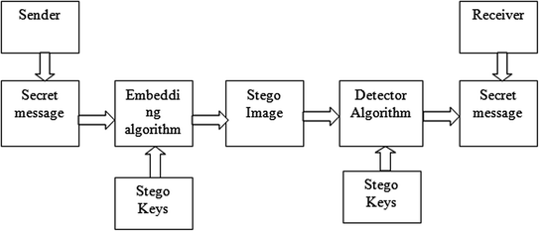
STEGANOGRAPHY

Slide 3
FOUR TYPES OF STEGANOGRAPHY
IMAGE STEGANOGRAPHY
TEXT STEGANOGRAPHY
AUDIO STEGANOGRAPHY
VIDEO STEGANOGRAPHY

Slide 4
TEXT STEGANOGRAPHY (text steganography via engaging Unicode standard encoding, 2020)

Slide 5
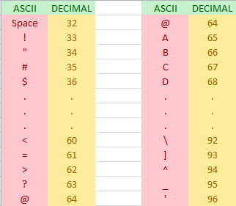
IF 32 >= P >= 64 : P = P + 32

Slide 6
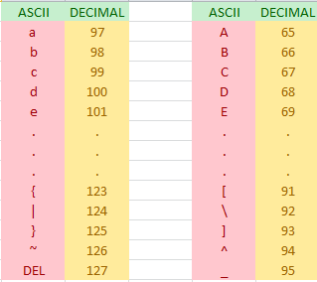
IF 64 > P >= 127 : P = P - 32

Slide 7
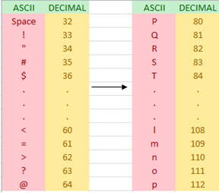
IF 32 >= P >= 64 : P = P + 48

Slide 8
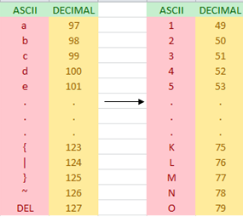
IF 64 > P >= 127 : P = P - 48

Slide 9
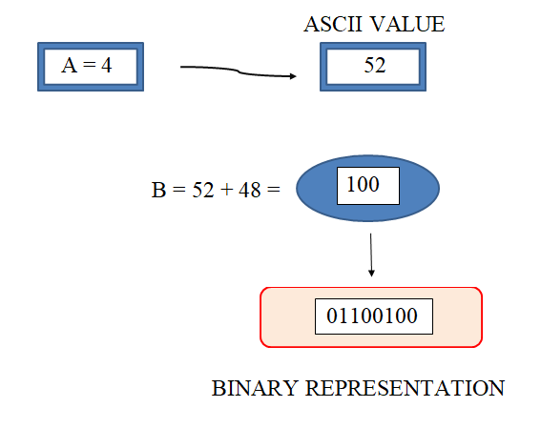
EXAMPLE 1

Slide 10
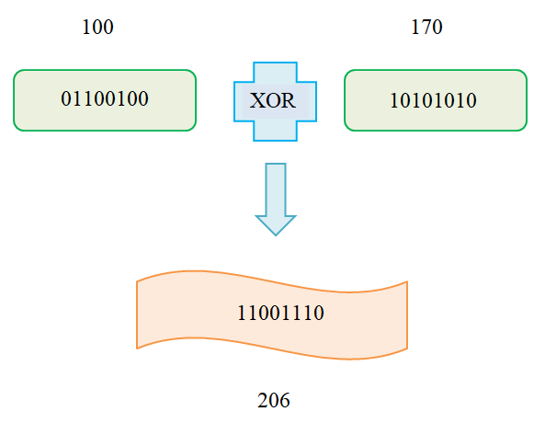

Slide 11
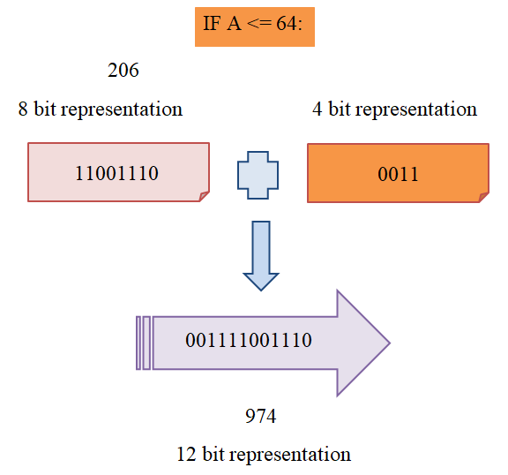

Slide 12
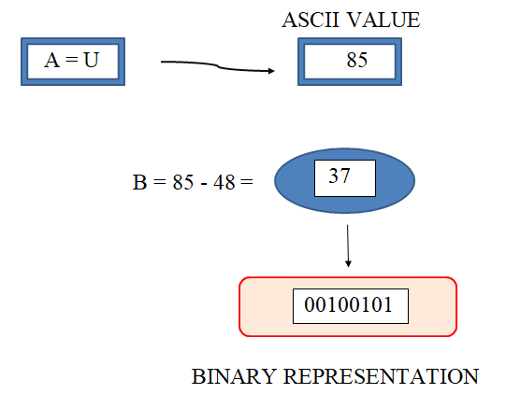
EXAMPLE 2

Slide 13
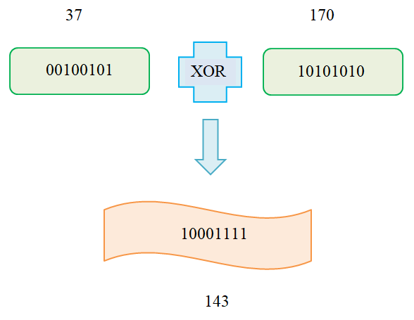

Slide 14
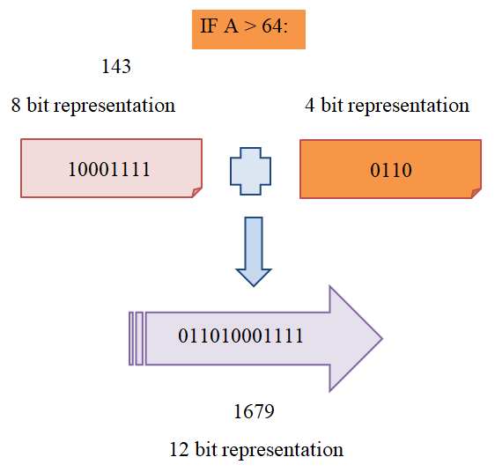

Slide 15
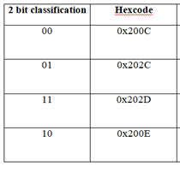
ZERO WIDTH CHARACTER

Slide 16
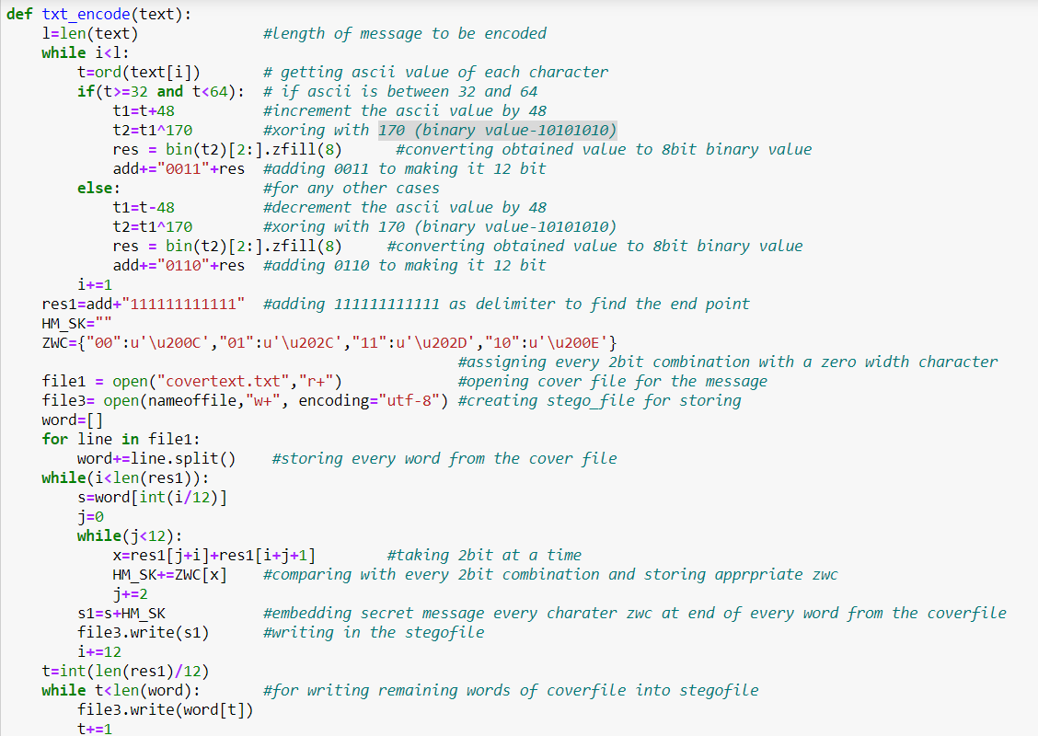
ENCODE

Slide 17
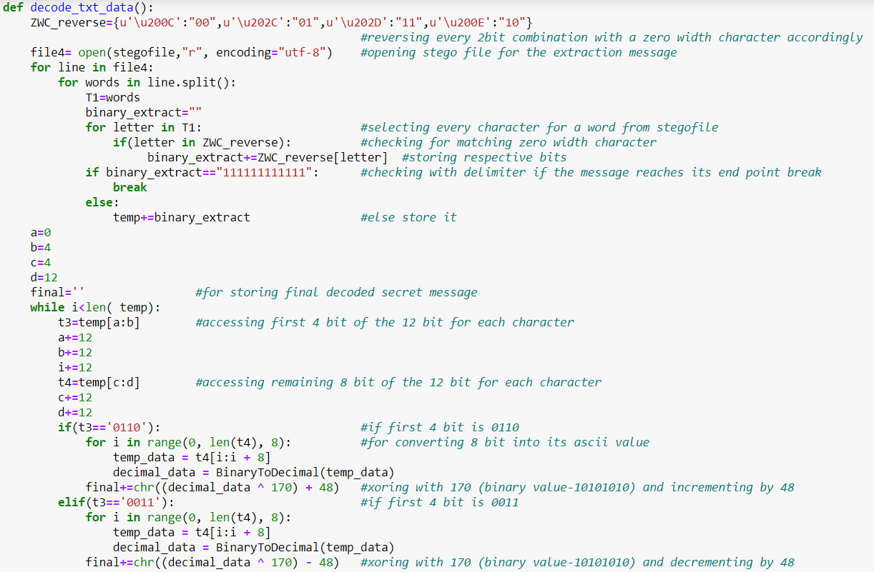
DECODE

Slide 18
IMAGE STEGANOGRAPHY (Using least significant bit algorithm, 2017)

Slide 19
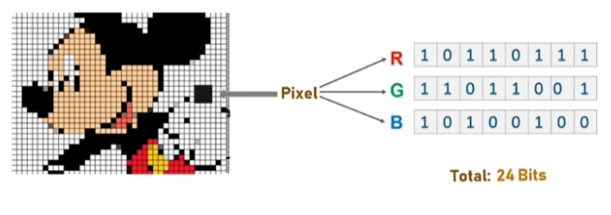
LEAST SIGNIFICANT BIT ALGORITHM
Photo credits to Edureka Steganography tutorial

Slide 20
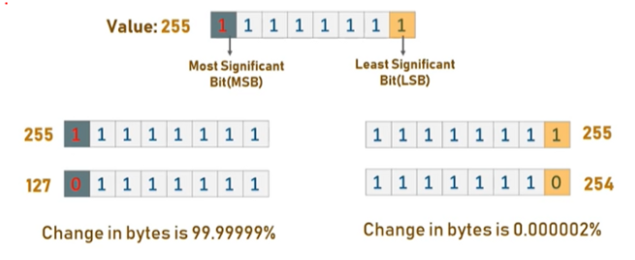

Slide 21
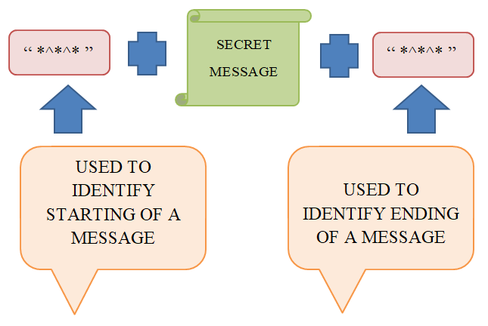
BASIC ALGORITHM

Slide 22
DISADVANTAGES
Less space available for message
Size of secret message
Distortion in image is visible

Slide 23
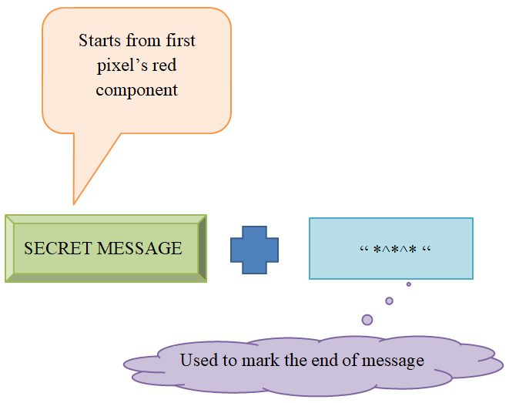
MODIFIED ALGORITHM

Slide 24
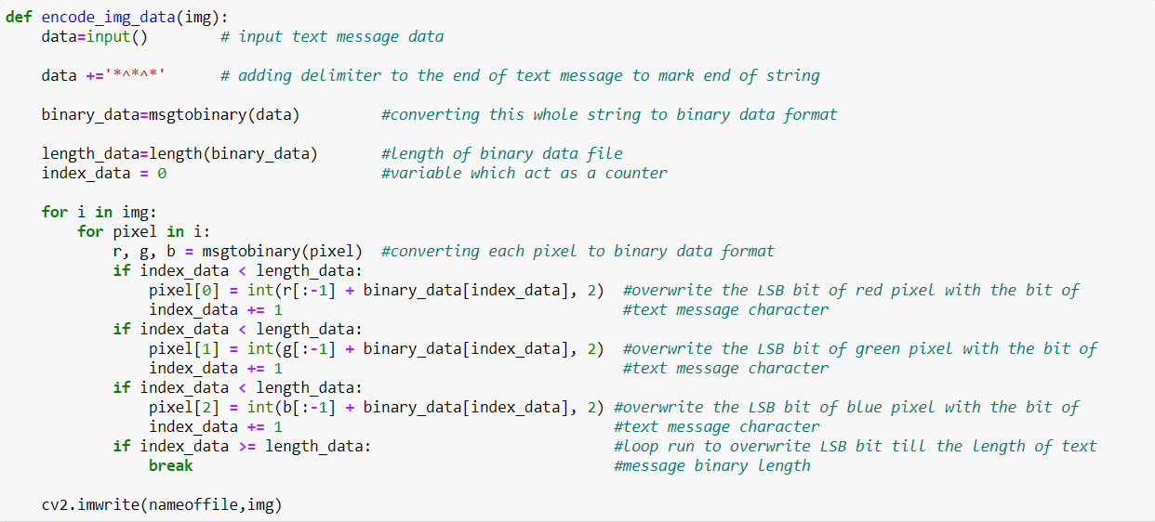
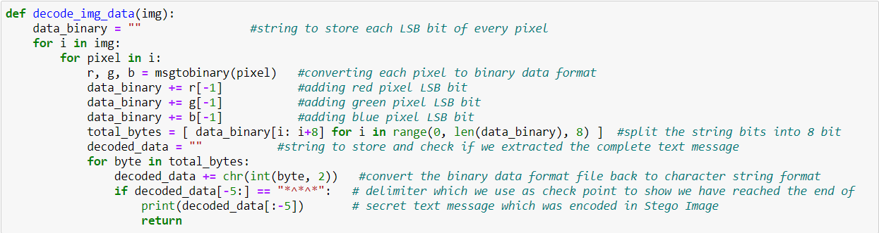
ENCODE AND DECODE

Slide 25
AUDIO STEGANOGRAPHY (LSB MODIFICATION USING ADVANCED ENCRYPTION STANDARD, 2018)

Slide 26
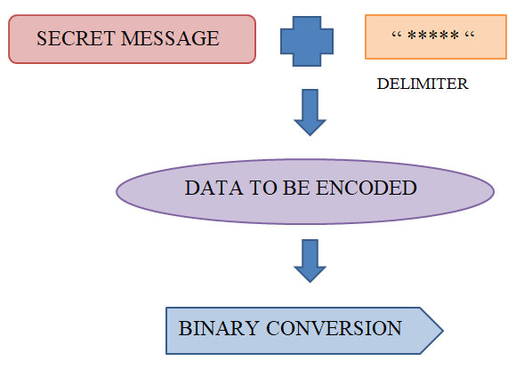

Slide 27
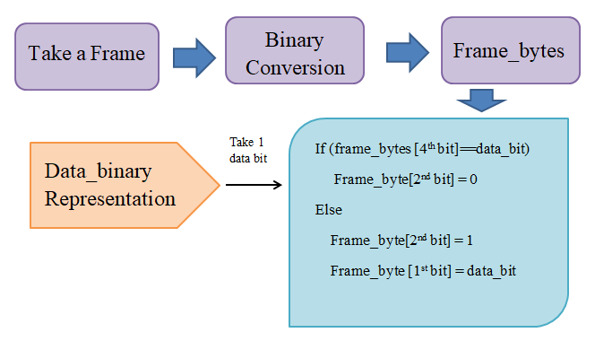

Slide 28
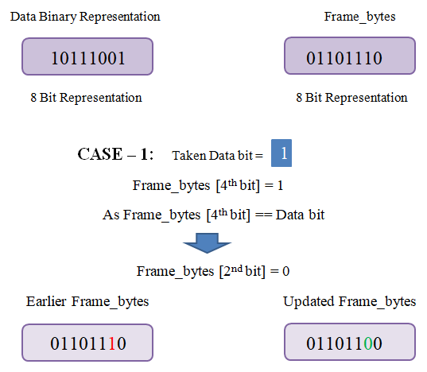

Slide 29
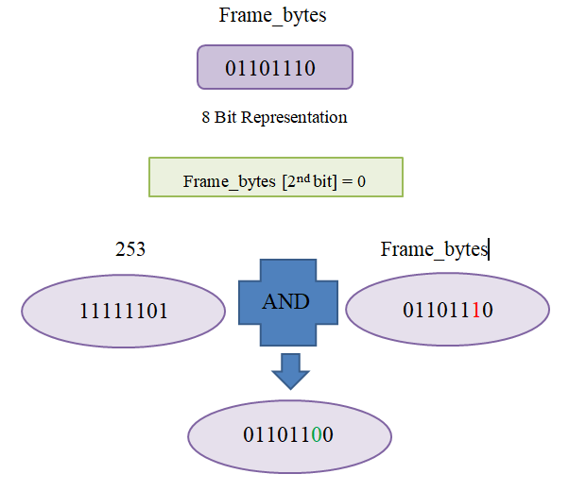

Slide 30
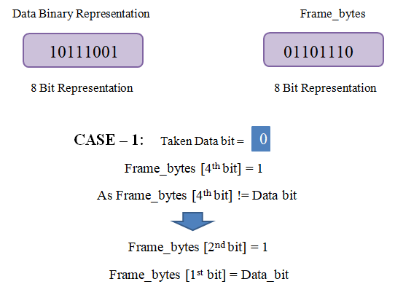

Slide 31
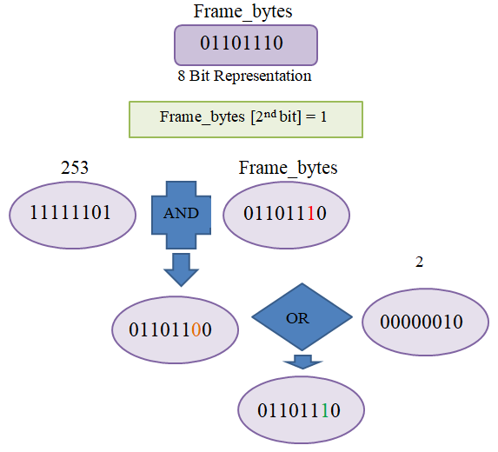

Slide 32
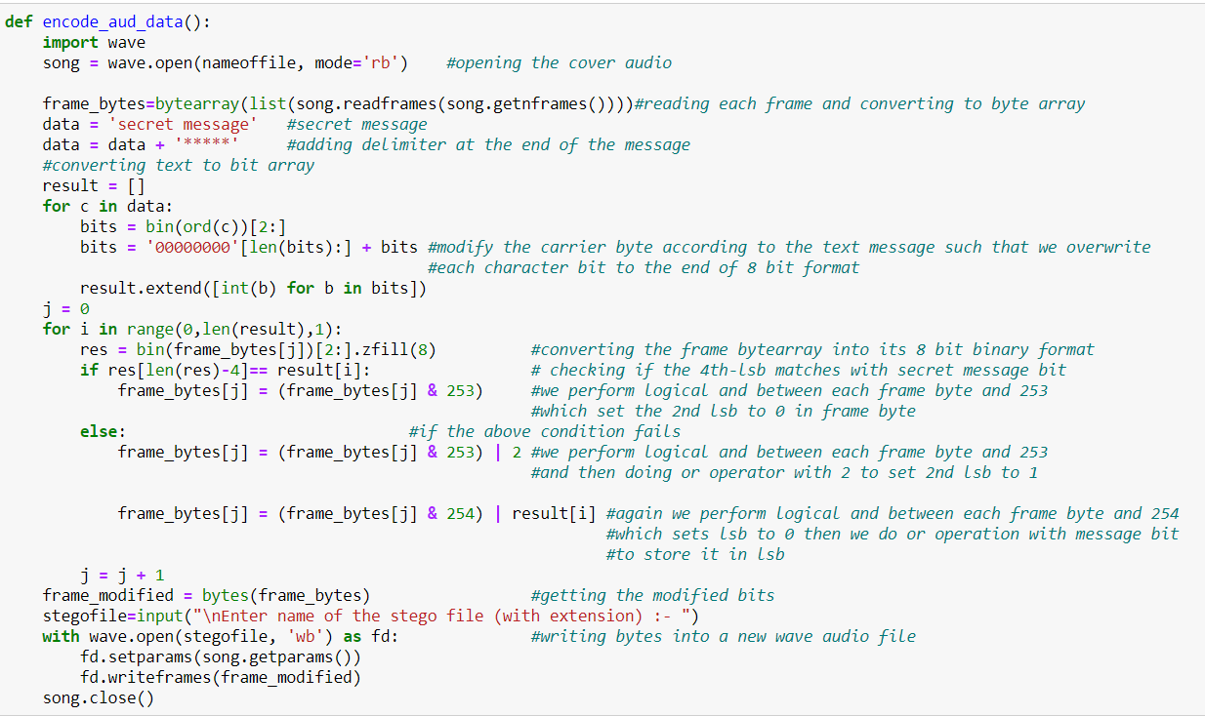
ENCODE

Slide 33
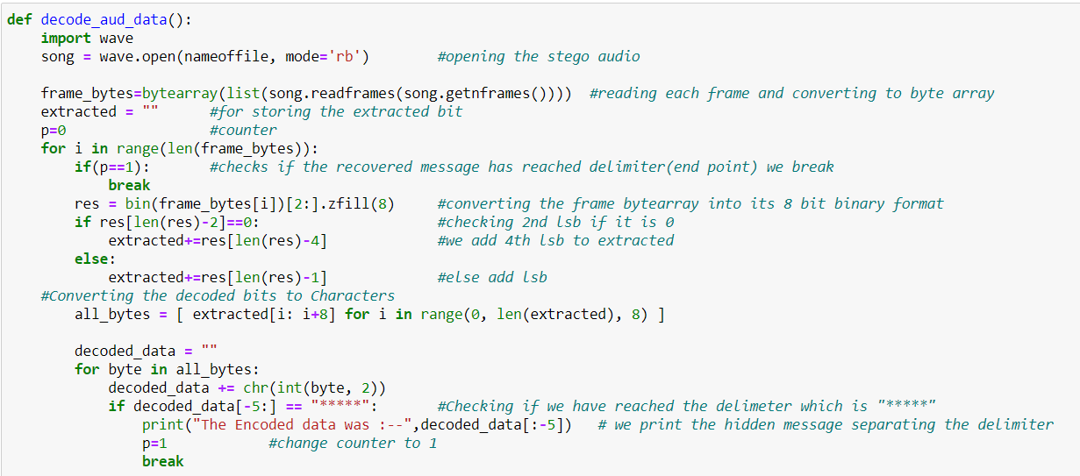
DECODE

Slide 34
VIDEO STEGANOGRAPHY (USING RC4 ALGORITHM FOR SECURITY APPLICATION, 2019)

Slide 35
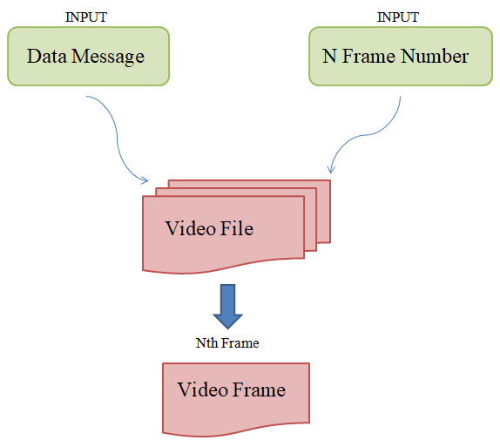

Slide 36
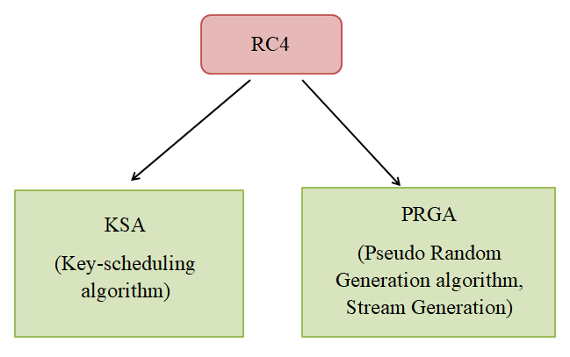

Slide 37
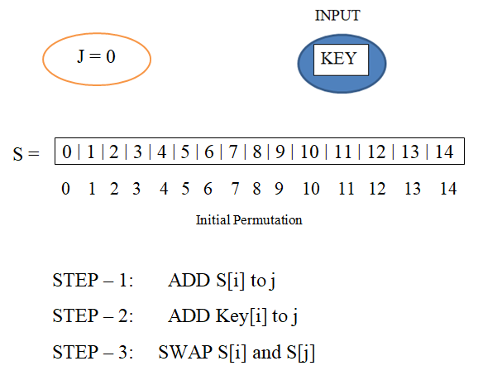
Ksa (Key-scheduling algorithm)

Slide 38
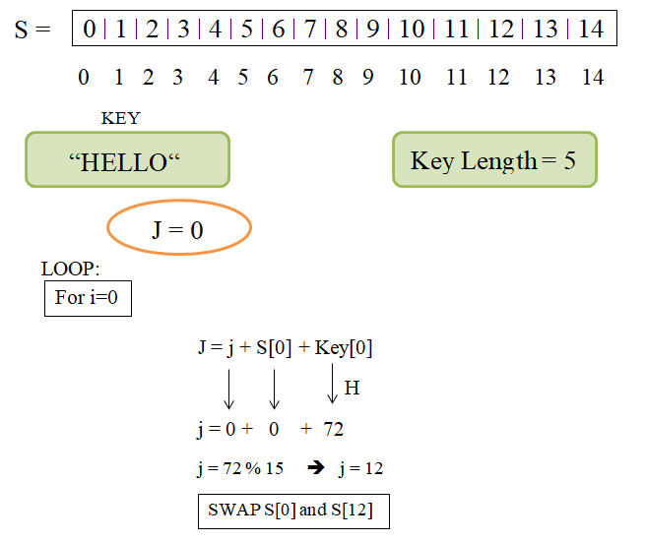

Slide 39
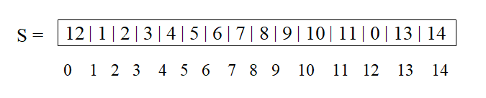
So now Permutation for next Iteration

Slide 40
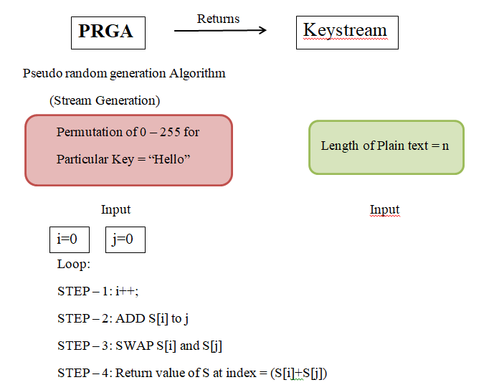
PRGA (Stream generation)

Slide 41
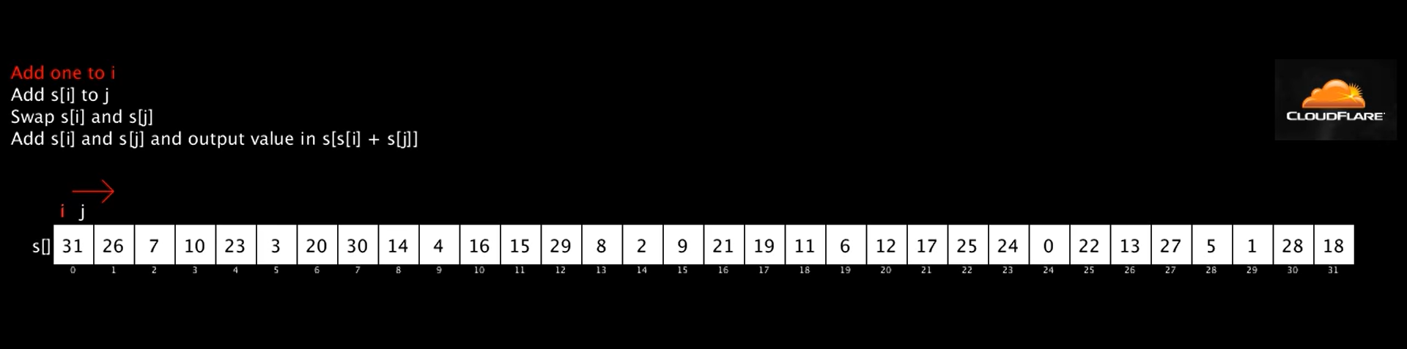

Slide 42
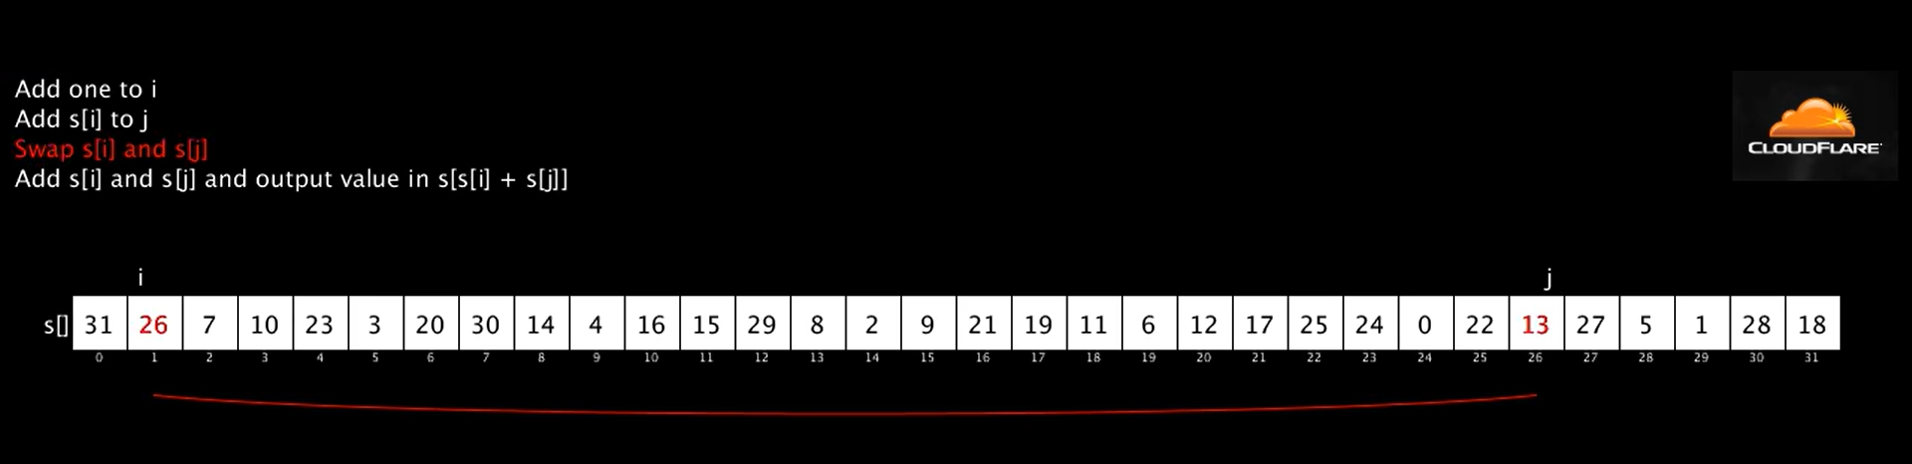

Slide 43
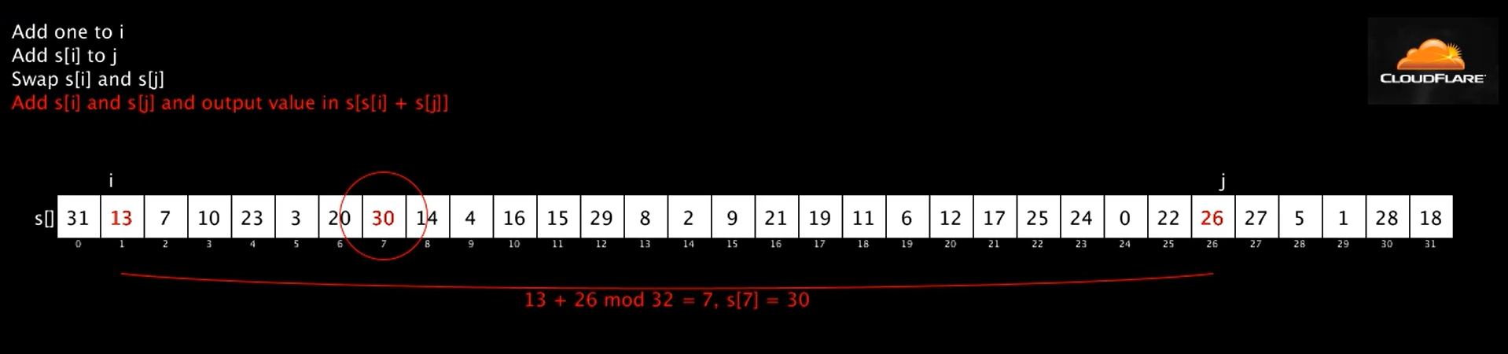

Slide 44
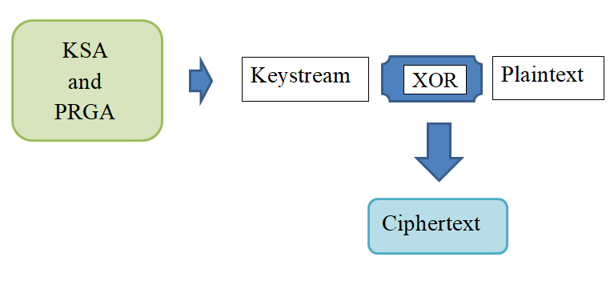
RC4 ENCRYPTION

Slide 45
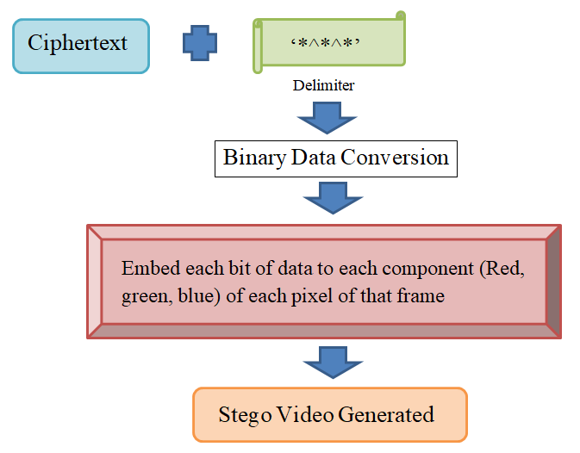

Slide 46
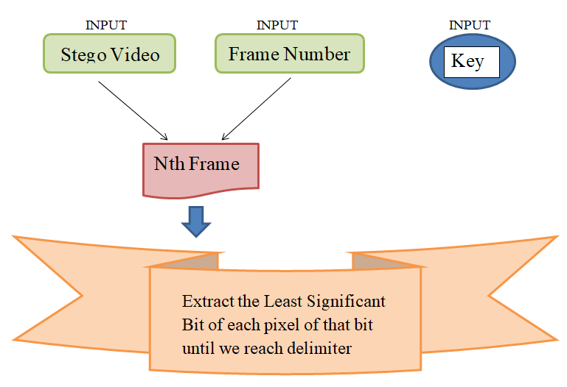
DECODE

Slide 47
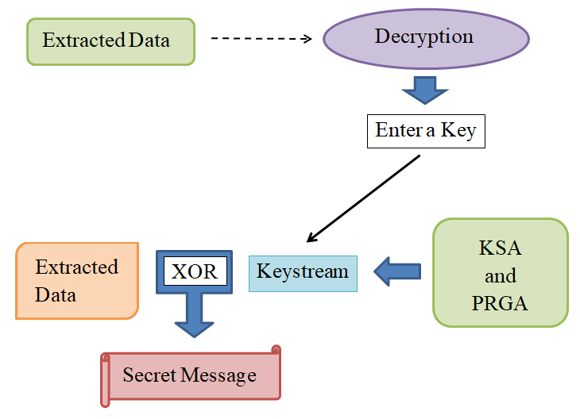

Slide 48
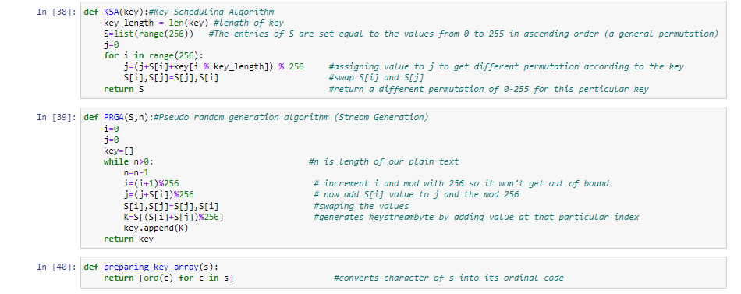
KSA AND PRGA

Slide 49
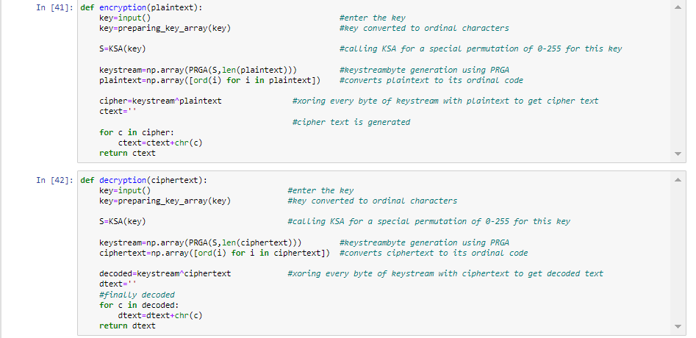
ENCRYPTION AND DECRYPTION

Slide 50
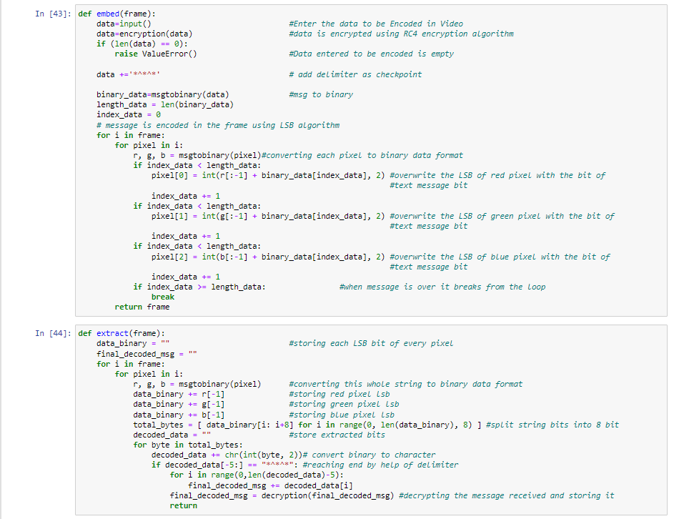
EMBED AND EXTRACT

